Slide 1
ASP .NET MVC 5
22 Mar 18 | Start
Appendix
Online

Slide 2
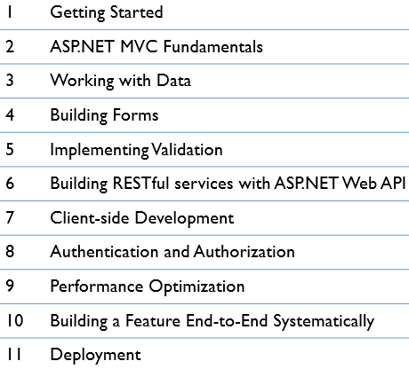
ASP.NET MVC 5
Ch | Date
1 | 00 May 18
2
3
4
5
6
7
8
9
10
11
ASP.NET MVC 5 - Mosh Udemy

Slide 3
1
Getting Started
Setting Up Development Environment
Adding a Theme

Slide 4
Sample Application
Vidly
Video Rental application Figure A0.
Has 2 roles:
Admin
Guest / Staff Member
It has three tabs:
Customers
Movies
New Rental
The application is more than CRUD operations. It has:
Pagination
Search utility
Business Rules
Validation Messages
You can login with Facebook as well.

Slide 5
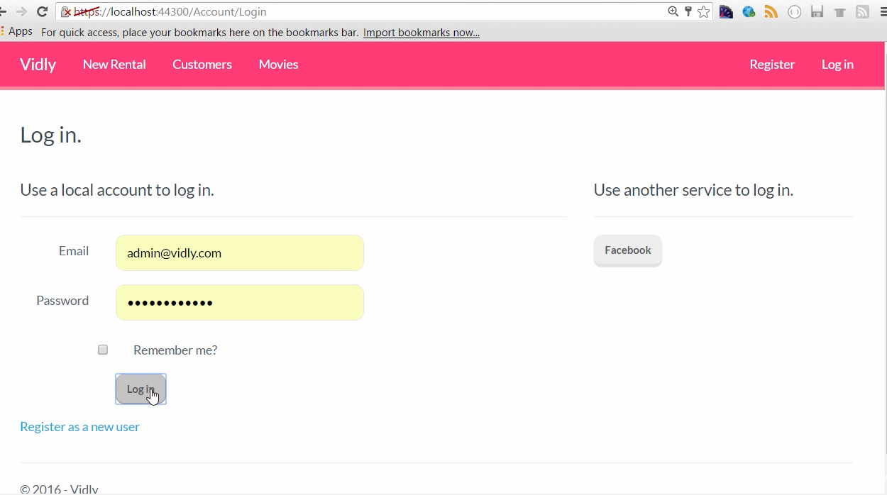
Figure A0

Slide 6
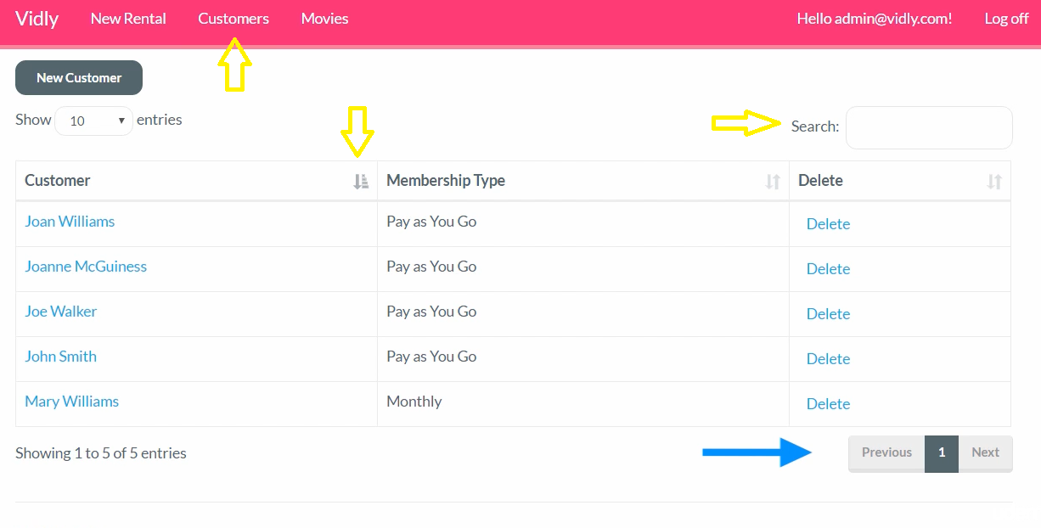
Figure A1

Slide 7
MVC Architectural Pattern
MVC Stands for Model-View-Controller.
It is one of the architectural patterns for implementing UI.
It was originally developed for Desktop applications around 1970s.
However, its been widely adopted in Web Application development resulting in the birth of many modern platforms.
Other popular frameworks include:
Ruby on Rails
Express for Node.js

Slide 8
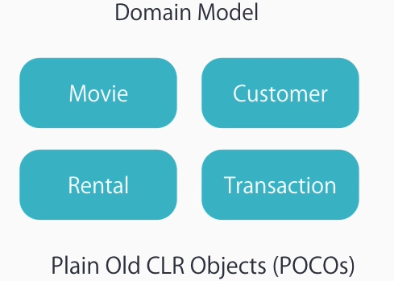
Model
Model represents the application data and behavior in terms of its problem domain, and independent of UI.
In our example, we have separate classes for Customers, Movies, Rentals and Transactions.
Each class is independent of business logic and represents the state of the application.
These are not tied to the user interface.

Slide 9
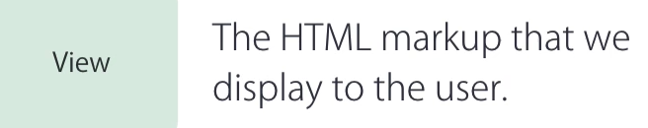
View
View represents the HTML markup displayed to the user.

Slide 10
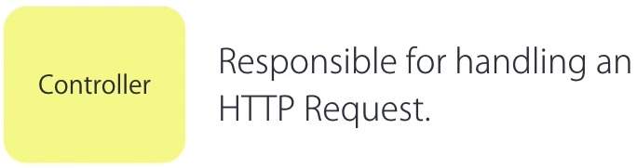
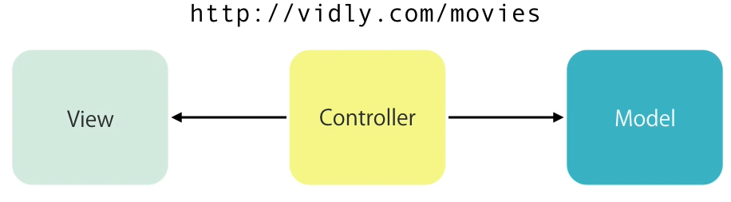
Controller
Responsible for handling an HTTP Request.
Suppose our application is hosted on Vidly.com, and a request to access Movies arrives as shown below:
A controller is selected to handle the request and it will fetch the data from the Model and present it to the user using View.

Slide 11
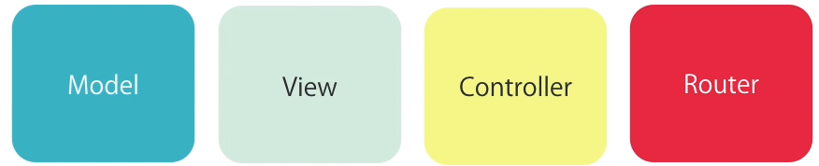
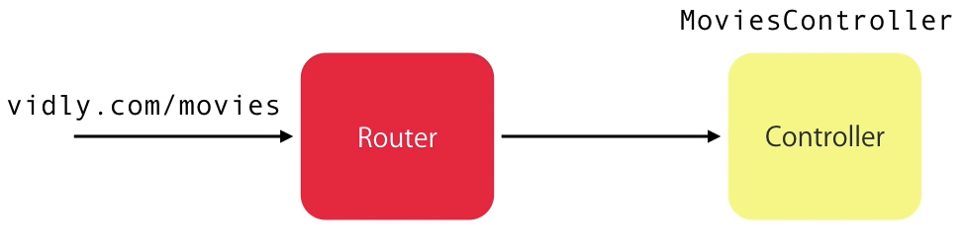
Router
Router is one of the most important component of MVC pattern though not part of the acronym.
When a request arrives at the URL, it is the job of the router to select the right controller to handle it.
The router is responsible for mapping the HTTP Request in the URL to an Action Method in the Controller class.

Slide 12
Setting Up Development Environment
The list of Tools required for MVC 5
Visual Studio 2013 or higher
Tools to increase productivity of software developed
Visual Studio Productivity Power Tools 2017
Web Essentials 2017
Resharper
Open Tools > Extensions and Updates (Figure 1)
Select Online on the left pane (Figure 2)
Key in the required tools in Search bar and install (Figure 3)

Slide 13
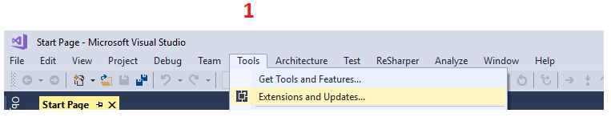
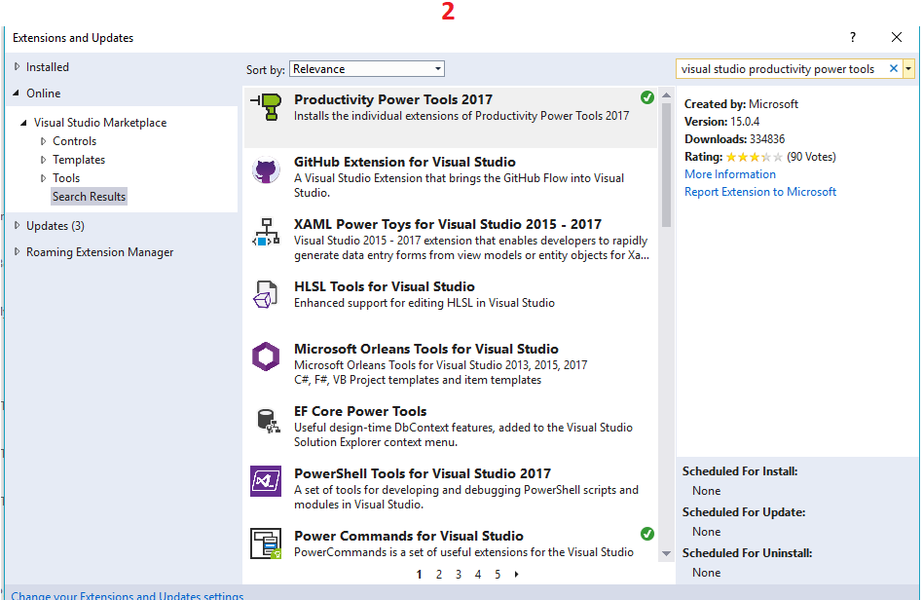
Figure 1 || 2

Slide 14
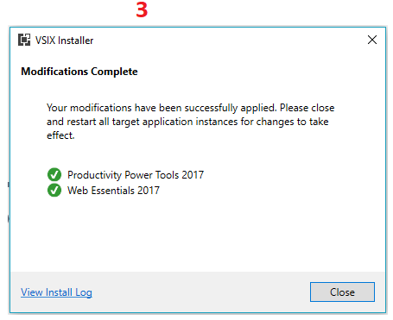
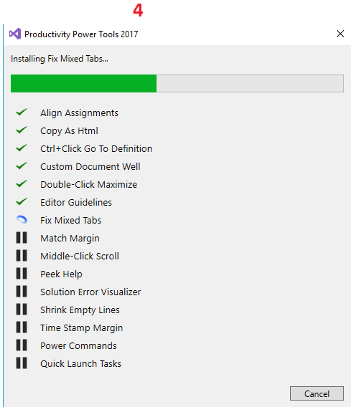
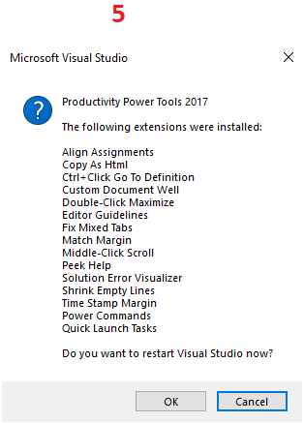
Figure 3

Slide 15
Adding a Theme
ASP.NET MVC application uses Bootstrap as its frontend CSS Framework.
Pick a theme from https://bootswatch.com/
Copy css code and add to Application/Content/bootstrap-<NewTheme>.css (Ex: bootstrap-Lumen.css)
Open BundleConfig.cs under App_Start Folder
Modify the file to reflect Figure 4

Slide 16
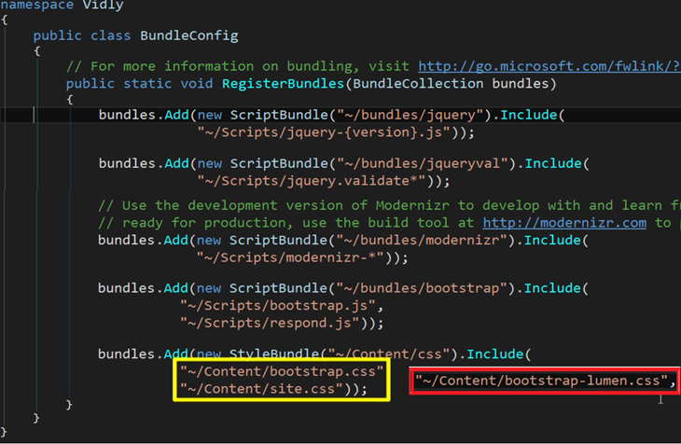
Figure 4

Slide 17
2
ASP.NET MVC Fundamentals
Action Results
Action Parameters
Convention-based Routing
Attribute-based Routing
Passing Data to Views

Slide 18
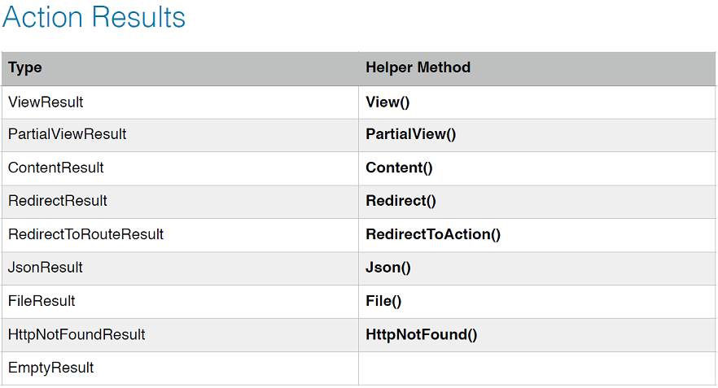
Action Results

Slide 19
Action Parameters
The various sources of Action Parameters are:
Embedded in the URL:
/movies/edit/1
In the query string:
/movies/edit?id=1
In the form data

Slide 20
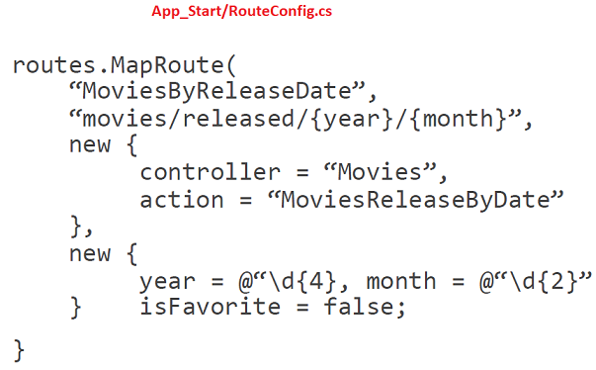
Convention-based Routing

Slide 21
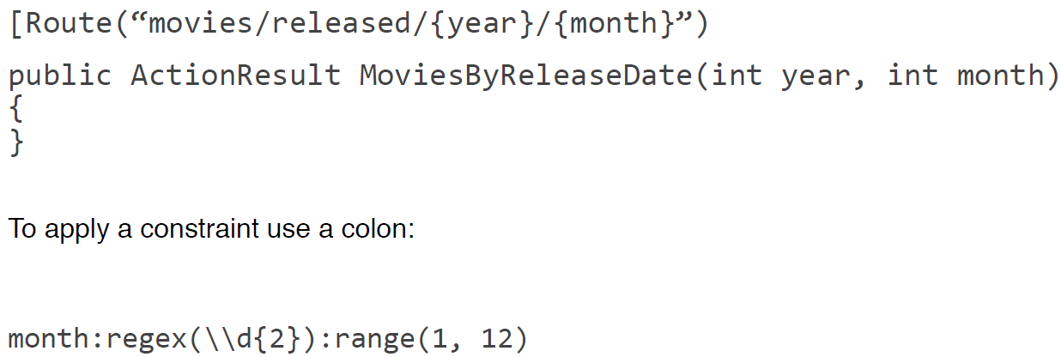
Attribute-based Routing

Slide 22

Passing Data to Views
Avoid using ViewData and ViewBag because they are fragile.
Plus, you have to do extra casting, which makes your code ugly.
Pass a model (or a view model) directly to a view:

